Slide 1
AngularJS
Module 3

Slide 2
Overview of AngularJS
Client Side Web Application Framework using Javascript
AngularJS is developed and maintained by Google.
Open Source and Free
released under the MIT License
Used to create front-end web framework for developing single-page applications SPA ( Single Page application), built using HTML, JS and Ts
originally developed by Misko Hevery and Adam Abrons at Google.

Slide 3
Separation of Concerns
AngularJS is an Model-View-Controller framework that is similar to the JavaScript framework
Separate DOM from the application logic
Component, templates, Services
Can create RIA, with including a wide range of third-party libraries, tools, and extensions
Cross Browser Compatible It can be easily added to HTML pages with simply a <script> tag
named angular after HTML as HTML contains angular brackets.

Slide 4
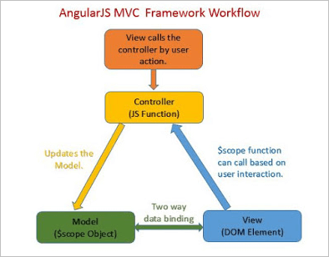






Module View Controller (MVC)
AngularJS designs the applications in MVC style
Divides application into 3 parts:
Views. Views are the components that display the application’s user interface (UI).
Models. Model objects are the parts of the application that implement the logic for the application’s data domain. Often, model objects retrieve and store model state in a database.

Slide 5
Controllers. Controllers are the components that handle user interaction, work with the model, and ultimately select a view to render that displays UI.
In an MVC application, the view only displays information; the controller handles and responds to user input and interaction.
View is independent of Model
Reusable Pattern
Decouple the Modules
Parallel Development
Multiple view support

Slide 6





Need of AngularJS in real web
Easy to Learn
HTML, JavaScript and CSS
It has a Two-Way Binding Feature ( bidirectional data flow)
AngularJS allows for an immediate synchronization between the view and the model. If any data is altered in the model, it reflects in the view. When changes are made in the view data, the model is revised accordingly.
Supports SPA features
faster website transition
Has a Declarative UI
Supported by large Community and Google
supported by different browsers
Incorporates the concepts of various languages including JavaScript and server-side languages.
Notes:
https://stackify.com/8-benefits-of-using-angularjs-for-web-app-development/
https://intellipaat.com/blog/tutorial/angularjs-tutorial/

Slide 7


It is a Powerful Framework
robust solution for faster front-end development
It has multiple features such as MVC pattern, directives, and dependency injection.
It is a common platform among developers because it is freely available.
This allows developers to expand the HTML syntax and build client-side applications.
Real-Time Testing
end-to-end and unit testing

Slide 8


AngularJS extension that is the Angular apps are built using the TypeScript language, which eliminates the errors while writing the codes and ensures high performance and security.
The time investment in Angular for the projects is less as compared to other web development frameworks. The Angular CLI tool allows the developers to create initial projects, perform testing, and integrate features in the same.
Reduce development time as Angular uses HTML to define the User-interface of an application, which is less complex as compared to JavaScript.

Slide 9
Environment Setup for AngularJS
Download the desired version of AngularJS ( https://angularjs.org/. OR use CDN
https://angularjs.org/
Including script from CDN:
<script src=”https://ajax.googleapis.com/ajax/libs/angularJS/1.7.2/angular.min.js”
type=”text/javascript”>
</script>
Including script from local machine:
<script src=” scripts/angular.js” type=”text/javascript”>
</script>

Slide 10
AngularJS projects often use Node.js for development tools (https://nodejs.org/en) and npm (Node Package Manager) for managing dependencies.
To Create Project
Create a new directory for your AngularJS project and navigate to it using the terminal or command prompt.
Install AngularJS
npm i @angular/core ( OR npm install angular@1.7.9 )
This step generates a skeleton application and includes all dependencies
Include html and other file
Run the application
npm install -g http-server
Notes:
Command to Bypass firewall : npm config set strict-ssl false

Slide 11
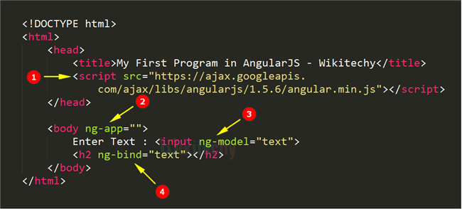
Sample Code
Notes:
https://www.softwaretestinghelp.com/angularjs-tutorial/

Slide 12






Data Binding
The Data Binding refers to the synchronization of data between the model and view.
Binding is an important concept as it acts as a bridge between the view and the logic of the AngularJS app
Data Binding In AngularJS is achieved by using Directives.
There are 2 major components of Data Binding in AngularJS:
Model: It is responsible for maintaining data in the application.
View: It is the HTML container where the app is displayed to the user.
AngularJS provides two types of Data Binding:
One-way data binding
Two-way data binding
Notes:
https://www.geeksforgeeks.org/how-many-types-of-data-bindings-in-angularjs/

Slide 13
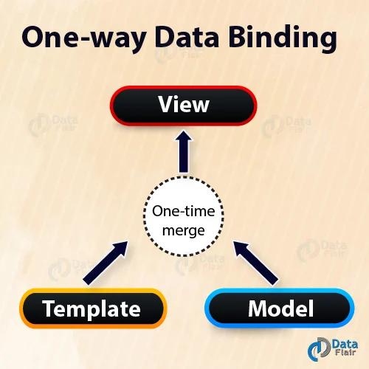







One Way Data Binding:
In one-way data binding, the flow of data is in one direction only i.e. from model to view.
A value is taken from the data model, inserted in an HTML element, and displayed to the user.
But there is no way to update the model according to the input given by the user which means that the data can’t flow from the view to the model.
One-Way Data Binding can be achieved by:
Interpolation
Using ng-bind directive

Slide 14





Interpolation/ expressions
AngularJS expressions can contain literals, operators or variables, unlike the traditional JavaScript.
add the ng-app directive, else the expression will be displayed as it is, without being solved.
AngularJS expressions could be written inside double curly braces or can be written inside a directive.
Syntax:
Inside curly braces:
<div ng-app=””>
<p>My first expression in Angular JS: {{3+3}}</p>
</div>
I

Slide 15
Inside directive:
<div ng-controller=”Name of your controller”>
<element ng-bind="your expression"></element>
</div>

Slide 16
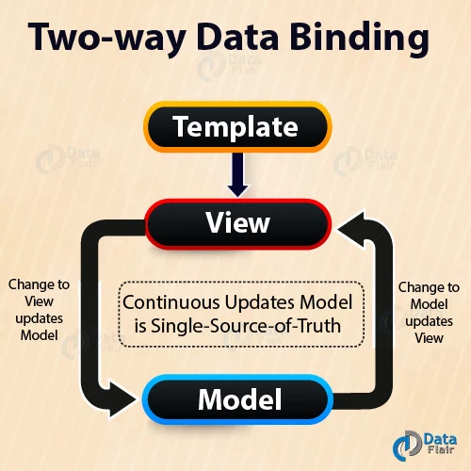







Two way Data binding
the flow of data is bidirectional i.e the data can flow from the model to the view as well as from the view to the model.
when the data in the model changes, the changes are reflected in the view and when the data in the view changes the model is also updated
Two-way data binding is achieved by using the ng-model directive, transfers data from the controller to the view and vice versa.

Slide 17
Datatype
Numbers
<div ng-app=””>
<p>The value of 5 times 10 is : {{5*10}}<p>
</div>
Strings
Strings can be initialized using ng-init directive or ng-controller directive. The concatenation of strings is also possible when the + operator is used within the expression.
Strings also could be used as expressions within double curly braces or use ng-bind directive just like the AngularJS numbers.
Notes:
https://www.softwaretestinghelp.com/angularjs-tutorial/

Slide 18




Inside curly braces:
<div ng-app=”” ng-init=”first string variable name=’your first string’; second string variable name=’your second string’ ”>
<p>My first string expression in Angular JS: {{ first string variable name + second string variable name }}
</p>
</div>

Slide 19









Inside directive:
<div ng-app=”” ng-init=” first string variable name=’your first string’;
second string variable name=’your second string’”>
<p>My first string expression in Angular JS:<span ng-bind=
" first string variable name + second string variable name "></span>
</p>
</div>

Slide 20








AngularJS Objects
AngularJS objects behave the same way in which the JavaScript objects behave.
The items within an object could be accessed using the dot operator.
Inside curly braces
<div ng-app=”” ng-init=”your object name={first variable name=’your first value’,second variable name=’your second value’}”>
<p>My first object in Angular JS: {{ your object name.second variable name }}</p>
</div>

Slide 21
Inside directive
<div ng-app=”” ng-init=”your object name={first variable name=’your first value’,second variable name=’your second value’}”>
<p>My first object in Angular JS:<span ng-bind=" your object name.second variable name "></span>
</p>
</div>

Slide 22





AngularJS Arrays
AngularJS arrays behave the same way in which the JavaScript arrays behave.
The items within an array could be accessed by denoting the value’s index number within square braces.
indexing starts from zero always
Inside curly braces:
<div ng-app=”” ng-init=”your array name=[your first value,your secondValue]”>
<p>My first array in Angular JS: {{ your array name[1] }}</p>
</div>

Slide 23






Inside directive:
<div ng-app=”” ng-init=”your array name=[your first value,your second value]”>
<p>My first array in Angular JS: <span ng-bind="your array name[1] "></span>
</p>
</div>

Slide 24

note, AngularJS:
Does not support conditionals, loops, and exceptions in expressions.
Does not support function declaration (even inside the ng-init directive) in expressions.
Does not support bitwise, comma, void and new operator in expressions.
Ignores the null or undefined properties in expressions.
Expressions are evaluated belonging to the scope object and not the global window.

Slide 25
Create Project
An AngularJS application consists of following three main parts −
ng-app− Defines and links application to HTML.
ng-model− Binds the values of application data to HTML input controls.
ng-bind− Binds the Application data to HTML tags.
Step 1: Load framework
<Script> tag.
Notes:
https://code.angularjs.org/

Slide 26
Step 2: Define Application using ng-app directive
<div ng-app = "">
//code
</div>
Step 3: Define a model name using ng-model directive
<p>Enter Text: <input type = "text" ng-model = "name"></p>
Step 4: Bind the value of above model defined using ng-bind directive.
<p>Hello<span ng-bind = "name"></span></p>

Slide 27
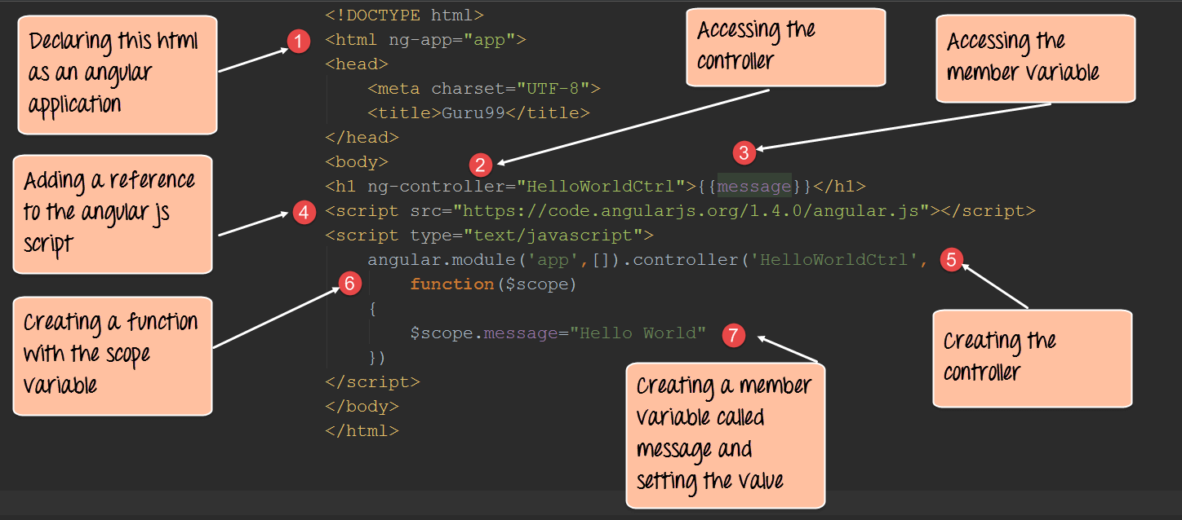
Sample Code

Slide 28




Directives
Tells the DOM what action ( controller) need to be done.
Directives are used like Attributes
2 types
Built in Directives - a set of built-in directives which offers functionality to your applications.
Custom Directives - lets you define your own directives.

Slide 29




Built in Directives
Start as ng-*
Eg:
ng-app − This directive defines and links an AngularJS application to HTML. start the AngularJS application.
ng-model − This directive binds the values of AngularJS application data to HTML input controls.
ng-bind − This directive binds the AngularJS Application data to HTML tags.
ng-value - bind value with a tag

Slide 30



ng-controller - to associate with a controller
ng-show, ng-hide - show or hide any control from DOM
ng-init - initialise any variable
ng-repeat - used for looping
ng-click - is like onclick(), is based on an event
ng-required - used for form validation
ng-disabled - enable or disable the control at runtime

Slide 31


Custom Directives
To implement our own directives.
AngularJS enables us to create new directives so that we can encapsulate and simplify DOM manipulation.
Custom directives are used to extend the functionality of HTML.
A custom directive simply replaces the element for which it is activated.
Custom directive can be for the following types.
Element directives: Directive activates when a matching element is encountered. Restrict mode is defined by “E”.
Example: <ng-directives></ng-directives>
Notes:
https://tutorial.techaltum.com/custom-directives-in-angularjs.html

Slide 32











Attribute: Directive activates when a matching attribute is encountered. Restrict mode is defined by “A”.
Example: <span ng-directive></span>
CSS: Directive activates when a matching css style is encountered.
Restrict mode is defined by “C”.
Example: <span class="ng-directive"></span>
Comment: Directive activates when a matching comment is encountered.
Restrict mode is defined by “M”.
Example <!-- directive: ng-directive -->
Notes:
https://www.c-sharpcorner.com/UploadFile/f0b2ed/angularjs-custom-directives/

Slide 33
Custom directives

Slide 34
AngularJS Modules
In AngularJS, a module defines an application.
It is a container for the different parts of your application like controller, services, filters, directives etc.
A module is used as a Main() method. Controller always belongs to a module.
Modules are used to separate logic such as services, controllers, application etc. from the code and maintain the code clean
A module is a collection of providers, services, directives etc., and optionally config and run blocks which get applied to the application during the bootstrap process.

Slide 35
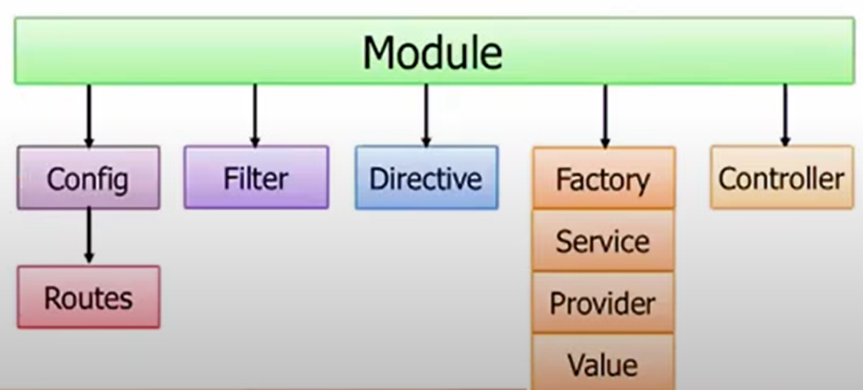
Modules are said to be the containers for different parts of an application
2 type of Modules
Application Module − used to initialize an application with controller(s).
Controller Module − used to define the controller.

Slide 36
Creating a Module in AngularJS:
var app = angular.module("Module-name", []);
[], we can add a list of components needed but we are not including any components in this case.
<div ng-app = "module-name">
The code in which the module is required.
</div>
Notes:
https://www.geeksforgeeks.org/angularjs-modules/

Slide 37
Adding a Controller:
app.controller("Controller-name", function($scope) {
$scope.variable-name= "";
});
Here, we can add any number of variables in the controller and use them in the HTML files, and the body of the tag in which the controller is added to that tag by writing:

Slide 38
Consolidating……
<body>
<div ng-app="Module-name">
<div ng-controller="Controller-name">
{{variable-name}}
</div>
<!-- This wont get printed since its not part of the div in which
controller is included -->
{{variable-name}}
</div>
</body>

Slide 39
Modules and controllers can be in the same file along with the HTML file which requires it however we may want to use this module in some other file.
Hence this will lead to redundancy so we will prefer to create Module, Controller, and HTML files separately.
The Module and Controller are to be stored by using .js files.

Slide 40
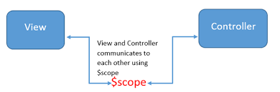
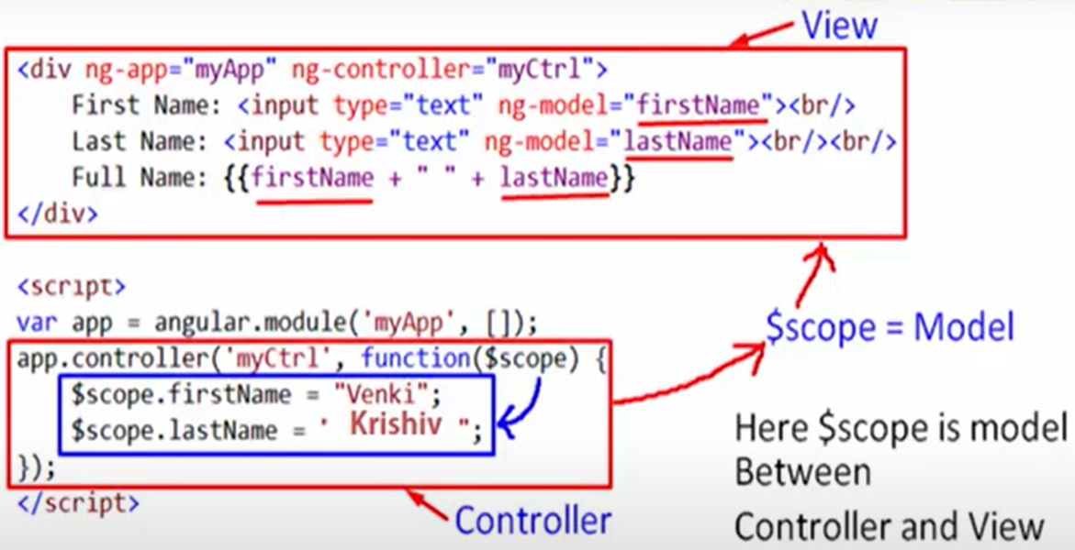



AngularJS scope
Scope is an object that refers to application model
It is used to bind between the view and the controller
Scope is accessible to both view and controller

Slide 41
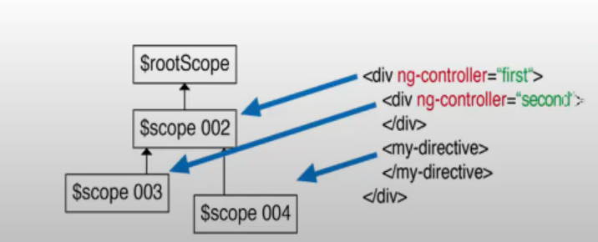


AngularJS controllers
Controllers control the application
controls the flow of data in that application
These are the JavaScript Objects that hold attributes and functions.
They are defined by a JavaScript constructor function that is used to augment the AngularJS Scope.
By using specific controller constructor function Angular will initiate a new constructor object and a new child scope is available as injectable parameter to the Controllers constructor function.
Scopes are organized in hierarchical structure which is initiated the DOM structure of the application
Notes:
https://intellipaat.com/blog/tutorial/angularjs-tutorial/angularjs-controllers/

Slide 42
It is defined by ng-controller.
It uses $scope as a parameter. $scope objects communicate with the view and expose the model to the view.
<div ng-app = "" ng-controller = "controller_name">
//code
</div>
Define in 2 ways
as an application module
as a JavaScript function.

Slide 43
An Application Module
angular.module("myapp", [])
.controller("appController", function($scope) {
// definition of controller
} );
JavaScript Function
function controllerAsFunction($scope){
//definition of controller
}
Controllers are also in external files ( see in Module)

Slide 44
Controllers are used to set up the initial state of the $scope object.
Add behavior to the $scope object.
When an application is created we need to set up the initial state for the AngularJS $scope.
You set up the initial state of a scope by attaching properties to the $scope object.
The properties contain the view model (the model that will be presented by the view).
All the $scope properties will be available to the template at the point in the DOM where the Controller is registered.
Also behaviour can be added to the Scope Object
Notes:
https://docs.angularjs.org/guide/controller

Slide 45
Do not use controllers to:
Manipulate DOM — Controllers should contain only business logic. Putting any presentation logic into Controllers significantly affects its testability. AngularJS has databinding for most cases and directives to encapsulate manual DOM manipulation.
Format input — Use AngularJS form controls instead.
Filter output — Use AngularJS filters instead.
Share code or state across controllers — Use AngularJS services instead.
Manage the life-cycle of other components (for example, to create service instances).

Slide 46

AngularJS Filters
Filter are functions that are used to format, transform, and filter data in expressions.
They allow you to modify the data before it is displayed to the user.
Filters can be applied in the view templates to format data without changing the underlying model
Filters can be applied to expressions in view templates using the following syntax:
{{ expression | filter }}
also {{ expression | filter1 | filter2 | ... }}

Slide 47

Filtering the data to show the data in a customized format
Used to modify the data representation
To specify search criteria
Can be clubbed with expressions
Eg:
Uppercase/ Lowercase
Currency
OrderBy
Filter
{{ name | uppercase }}
{{ amount | currency }}
{{ date | date:'MM/dd/yyyy' }}

Slide 48
Custom Filters
A custom filter can be created by registering a filter factory function in a module.
They are functions that return a function
Use the filter function to create a custom filter
The AngularJS filter function should be a pure function, meaning it should produce the same result as per the given input, and it should not have any effect on an external state.

Slide 49


AngularJS Forms
AngularJS performs form validation on the client side
2 ways
AngularJS adds CSS classes to forms and input fields depending on their states.
ng-untouched The field has not been touched yet
ng-touched The field has been touched
ng-pristine The field has not been modified yet
ng-dirty The field has been modified
ng-valid The field content is valid
ng-invalid The field content is not valid

Slide 50
Form State and Input State
AngularJS is constantly updating the state of both the form and the input fields
$untouched The field has not been touched yet
$touched The field has been touched
$pristine The field has not been modified yet
$dirty The field has been modified
$invalid The field content is not valid
$valid The field content is valid

Slide 51




AngularJS Services
In AngularJS, Services are objects that provide some sort of service that can be reused with in an angular application.
Instead of writing the code for every component separately to perform the same function, Angular service is used to write the code once and inject it into every component
Like other JS objects they too have has properties and methods
2 types
Built in Services
AngularJS has lot of built in services
Eg: $http, $log
Custom Services

Slide 52
Why do we need services in an angular application
The primary responsibility of the controller is to build the model for the view. The controller should not be doing too many things if the logic with in your controller, is becoming too large or too complex, then use service.
Reusability :
In a service you usually have a logic that you want to reuse with in your entire application.
Dependency Injection : Another benefit of services, is that, they can simply be injected into controllers or other services that need them.
Testability : Since services are injected into controllers or other services that need them, it becomes very easy to test them.

Slide 53
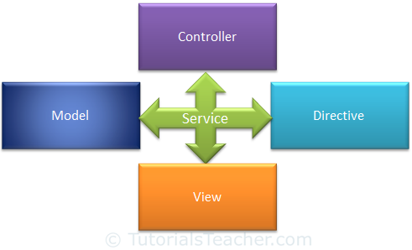
Services can be used to organize and share code across your app.
AngularJS services are: Lazily instantiated – AngularJS only instantiates a service when an application component depends on it.
AngularJS services interact with the controller, model or custom directives.
However, some services interact with view (UI) also for UI specific tasks
They follow Singleton Patterns
Notes:
https://www.tutorialsteacher.com/angularjs/angularjs-service

Slide 54
$http service
Used to make HTTP requests to remote server
$http service is used to send or receive data from the remote server using browser's XMLHttpRequest
it has a single input parameter i.e a configuration object.
$http({
method: 'GET',
url: 'EmployeeService.asmx/GetAllEmployees'
});

Slide 55
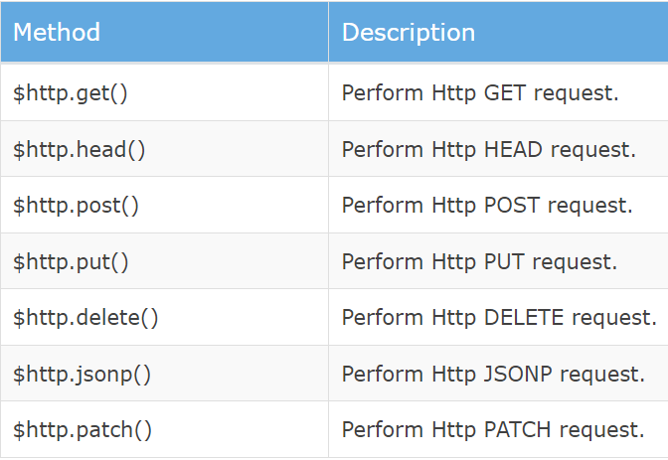
includes following
shortcut methods
$http service returns a promise object.
This means the functions are executed asynchronously and the data that these functions return may not be available immediately.

Slide 56
AngularJS dependency injection
Dependency Injections are
Software Design Pattern
Create components with Single Responsibility,
Reusability
Loosely coupled code
Maintainability
testing becomes easy
It allows the AngularJS application to divide into smaller modules
One injected to another
Modularization
Notes:
https://www.softwaretestinghelp.com/angularjs-tutorial/
https://intellipaat.com/blog/tutorial/angularjs-tutorial/angularjs-dependency-injection/

Slide 57
DI are implemented in AngularJS as
Value
Injecting a Value
Factory
Injecting Values into a Factory
Service
Injecting Values into a Service
Providers
Configuring a Provider
Constants
Dependencies Between Modules
Notes:
https://www.knowledgehut.com/blog/web-development/dependency-injection-in-angularjs

Slide 58
Value
myMod.value("numberValue", 10);
myMod.value("stringValue", "aaa");
myMod.value("objectValue", { field1 : 123, field2 : "abc"} );
Constant
Config Phase of AngularJS has some restrictions for injected values, as you cannot inject values into the module.config() function.
Instead constants are used to pass values at config phase.
To define a constant value we use the constant() function of the defined module.
Then for the constant parameter we provide a constant value.
Notes:
https://www.geeksforgeeks.org/angularjs-factory-method/

Slide 59




Factory
factory is a function that is used to return a value.
This function creates the value on demand whenever a service or controller needs any value injected from the factory.
AngularJS applications normally use a factory function to calculate and return a value.
difference between an AngularJS service and factory is that a service is a constructor function and a factory is not. That is why, in the case of a factory, we return an object literal instead of using this.

Slide 60



Service
Services are created by using service() function on a module and then injecting it into controllers.
Providers
In AngularJS, a provider is used to internally create other values or services or factory during config phase (the phase during which AngularJS bootstraps itself).
Provider can be considered to be the most flexible form of factory you can create.
Provider is a special factory method with a get() function which is used to return the value or service or factory

Slide 61
Controllers are to do with view related business logic. Services, on the other hand, are to do with reusable business logic independent of the views.
Factory is that a service is a constructor function and a factory is not. That is why, in the case of a factory, we return an object literal instead of using this

Slide 62


Routing
In AngularJS we build Single Page Application (SPA) with AngularJS.
It is a web app that loads a single HTML page and dynamically updates that page as the user interacts with the web app.
AngularJS ngRoute module provides routing
download angular-route.js script or use CDN
ngRoute module routes your application to different pages without reloading the entire application.
[ Install AngularJS http server if required
Install server
npm install -g http-server
Move to the project folder
To run server
http-server
]

Slide 63
load the ngRoute module in your AngularJS application by adding it as a dependent module
$routeProvider is used to configure the routes.
use the ngRoute config() to configure the $routeProvider.
The config() takes a function which takes the $routeProvider as parameter and the routing configuration goes inside the function.
$routeProvider has a simple API, accepting either the when() or otherwise() method.
application needs a container to put the content provided by the routing
ngView directive is used to display the HTML templates or views in the specified routes.
Every time the current route changes, the included view changes with it according to the configuration of the $route service.

Slide 64
Built-in Helper Functions
angular.copy
angular.equals
angular.forEach
angular.fromJson
angular.identity
angular.isArray
angular.isDate
angular.isDefined
angular.isUndefined
angular.isElement
angular.isFunction
angular.isNumber
angular.isObject
angular.isString
angular.merge
angular.noop
angular.toJson

Slide 65
Using Angular JS with Typescript
NOT DONE

Slide 66
